Slide 1
Getting to Know You

Slide 2
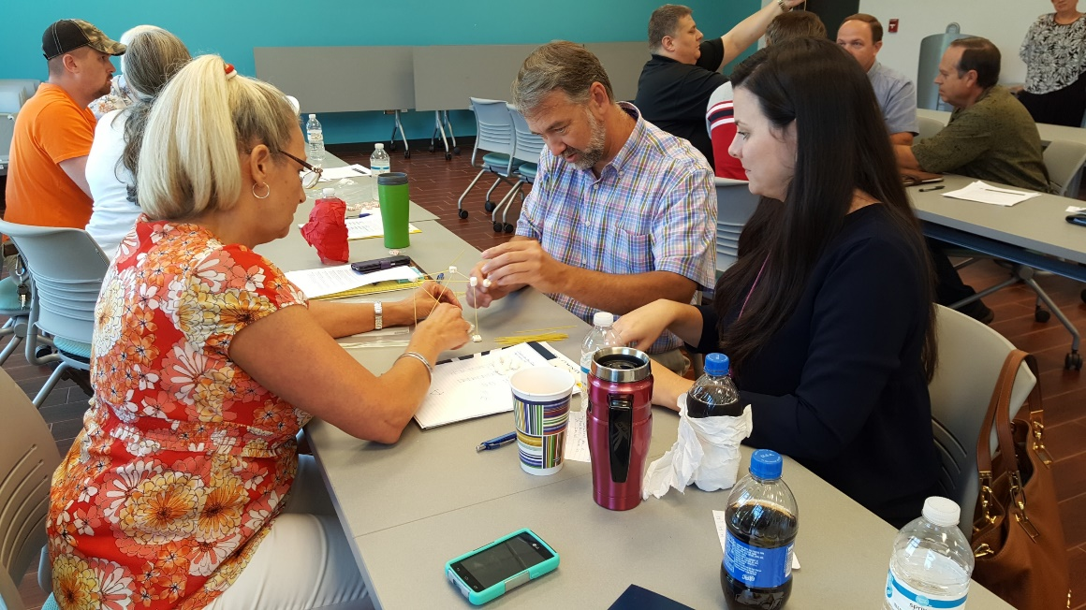
Getting to Know You
On the paper airplane template:
Write down 3 things about yourself that you are willing to share with others
DO NOT put your name on the paper
Make the airplane
Await further instructions

Slide 3
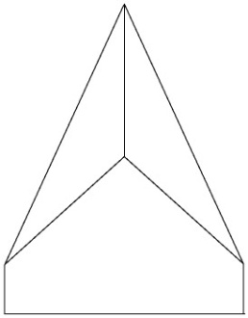
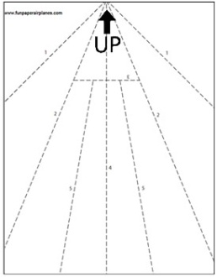
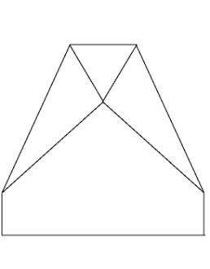
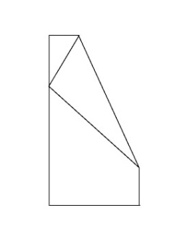
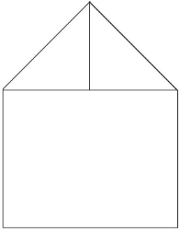
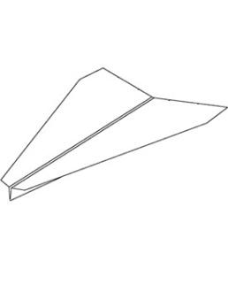
Getting Acquainted
Step 4: Fold the right side over again and crease along fold line 2.
Repeat with the left side.
Step 1: Orient the template with the “UP” arrow at the top of the page.
Step 5: Fold the tip down toward you and crease along fold line 3.
Step 2: Flip the paper over onto its backside so that you cannot see the fold lines. Write down 3 things about yourself others might not know.
Step 6: Now, flip the paper over. Then, fold the left side over onto the right side and crease along fold line 4 so that the outside edges of the wings line up.
Step 3: Pull the top right corner down toward you until fold line 1 is visible and crease along the dotted line. Repeat with the top left corner.
Step 7: Fold the wings down along fold lines 5. Partially open the folds you just created so that the wings stick out straight. The wings will have a slight “V” shape when viewed from the front.

Slide 4
Fly Planes Until Told to Stop

Slide 5
Identify the Person on the Plane You Have
You MAY NOT ask if it is a person
Is this your plane
You should ask a question specific to one item
For example Do you like pizza?
If the person answers Yes, you can ask the next question
When you have identified the person make sure you get their name because you’re going to have to introduce them!
Remember, even if you have identified your person, someone might be looking for you – you need to both ask and answer questions

Slide 6
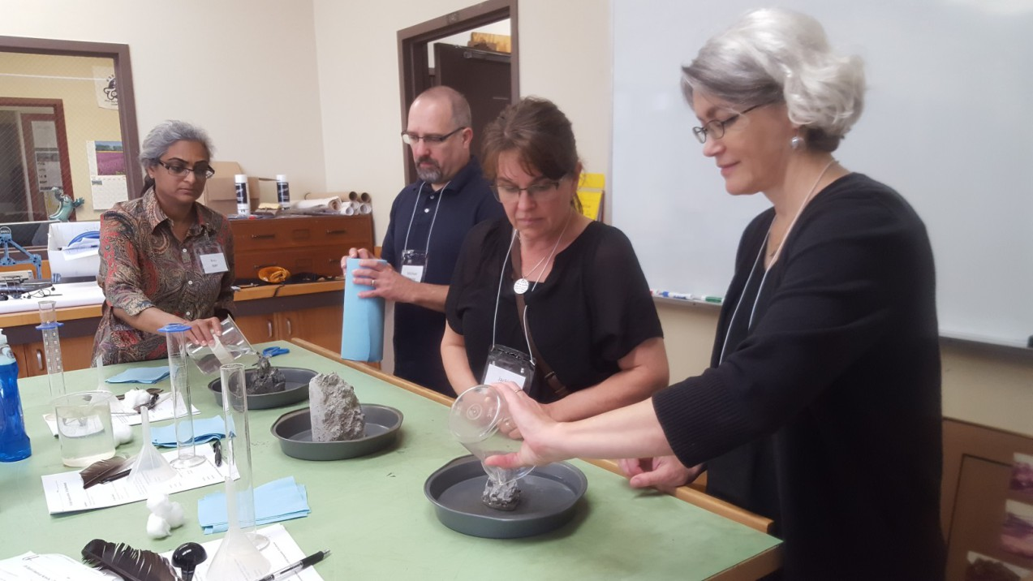
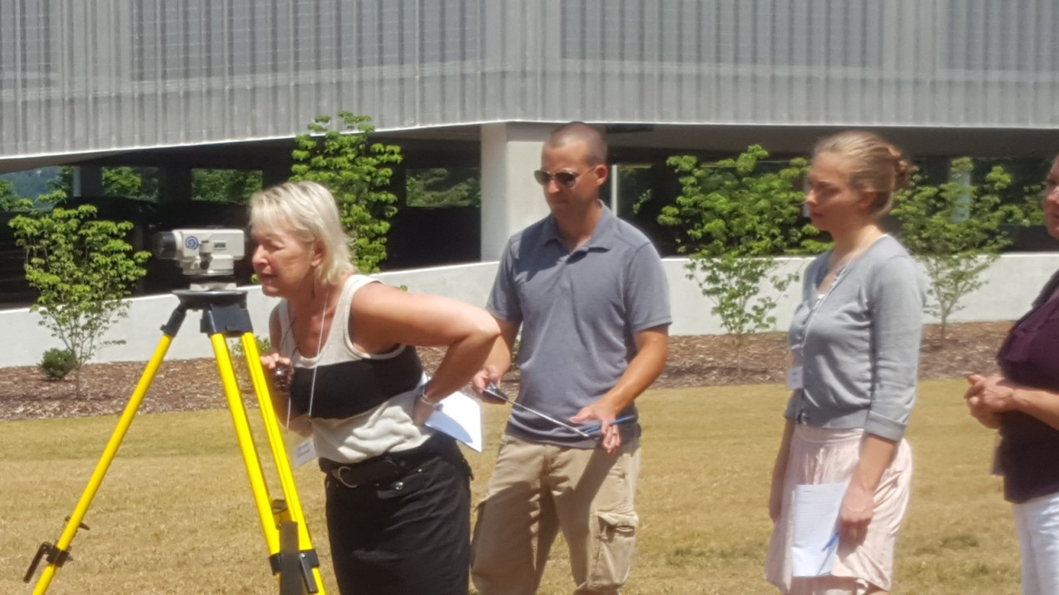
Introductions
Form a circle
Introduce to the entire group the person you identified
Share the 3 things they wrote about themselves

