Slide 1
CyberSecurity
What is it?
http://creativecom mons.org/licenses/by-nc-sa/4.0/
Notes:
Please give author attribution when using these slides.
Downloaded from engage-csedu.org

Slide 2
Cyber security focuses on protecting computers, networks, programs and data from unintended or unauthorized access, change or destruction.
Notes:
Source: Winnie Yu & Lisa Lancor, Southern Connecticut State University. Downloaded from engage-csedu.org.

Slide 3
Cybersecurity Jargon
The field of cybersecurity is evolving day by day.
Keeping up with the the jargon can be quite fun. Let’s take a look as some of the terms that are used in field of cybersecurity….
We will be talking about “digital forensics” and ”Zero Day attacks” today.
Notes:
Source: Winnie Yu & Lisa Lancor, Southern Connecticut State University. Downloaded from engage-csedu.org.

Slide 4
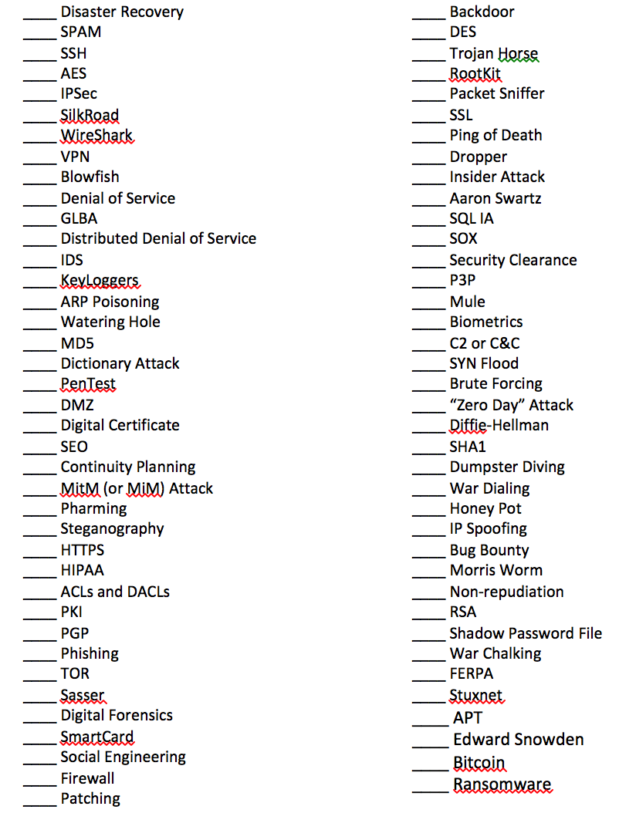
Notes:
Source: Winnie Yu & Lisa Lancor, Southern Connecticut State University. Downloaded from engage-csedu.org.

Slide 5
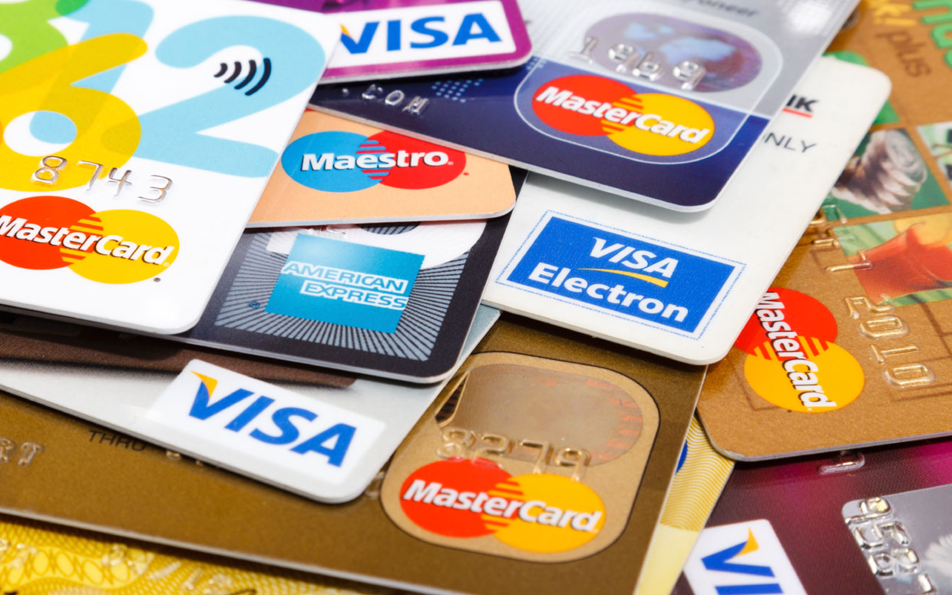
Credit Cards: How do they work?
Notes:
Source: Winnie Yu & Lisa Lancor, Southern Connecticut State University. Downloaded from engage-csedu.org.

Slide 6
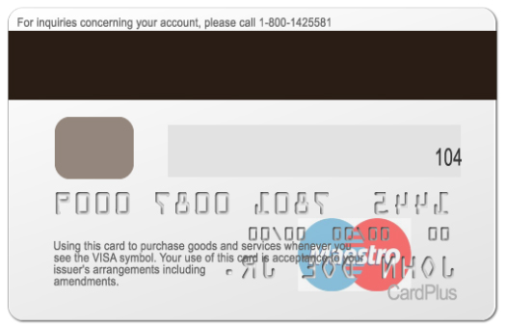
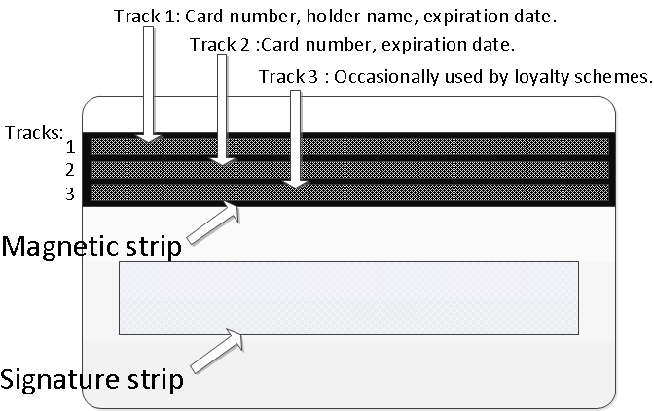
Where is your CC info stored?
http://blogs.cisco.com/security/detecting-payment-card-data-breaches-today-to-avoid-becoming-tomorrows-headline
Notes:
Source: Winnie Yu & Lisa Lancor, Southern Connecticut State University. Downloaded from engage-csedu.org.

Slide 7
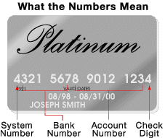
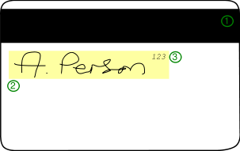
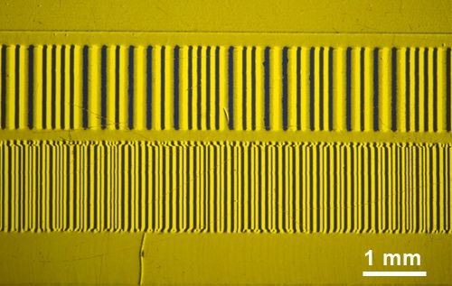
Background on CCs
3 Tracks of data on magnetic strip (MagStrip)
  Track one is 210 bits per inch (bpi), and holds 79 6-bit plus parity bit read-only characters.
  Track two is 75 bpi, and holds 40 4-bit plus parity bit characters.
  Track three is 210 bpi, and holds 107 4-bit plus parity bit characters.
https://en.wikipedia.org/wiki/Magnetic_stripe_card
Notes:
Track one usually holds customer’s name:
Source: Winnie Yu & Lisa Lancor, Southern Connecticut State University. Downloaded from engage-csedu.org.

Slide 8
Background on CCs
CC typically use only tracks 1&2
  Track 3, not standardized, R/W track includes encrypted PIN, Country Code, Currency Units, Amount Authorized
  Track 2 (developed by Banking industry)
    Start sentinel - one char, usually ‘;’
    Primary account number - up to 19 chars (CC#)
    Separator - one character, usually ‘=‘
    Expiration date or separator - 4 chars (YYMM)
    Service Code – 3 chars, int’l?
    Discretionary data – can be CVV (Card Verification Value), PIN Verification value, (upto 40 chars total)
    End sentinel – 1 char, usually ‘?’
    LRC – Longitudinal Redundancy Check, one char.
http://en.wikipedia.org/wiki/Magnetic_stripe_card
Notes:
Source: Winnie Yu & Lisa Lancor, Southern Connecticut State University. Downloaded from engage-csedu.org.
Service code values common in financial cards:
First digit
1: International interchange OK
2: International interchange, use IC (chip) where feasible
5: National interchange only except under bilateral agreement
6: National interchange only except under bilateral agreement, use IC (chip) where feasible
7: No interchange except under bilateral agreement (closed loop)
9: Test
Second digit
0: Normal
2: Contact issuer via online means
4: Contact issuer via online means except under bilateral agreement
Third digit
0: No restrictions, PIN required
1: No restrictions
2: Goods and services only (no cash)
3: ATM only, PIN required
4: Cash only
5: Goods and services only (no cash), PIN required
6: No restrictions, use PIN where feasible
7: Goods and services only (no cash), use PIN where feasible

Slide 9
How is the MagStripe Read?
Any reader capable of reading magstripes can access the data stored on the card’s magnetic stripe.
Typically, magstripe data is read by a Point of Sale (POS) device in a retail store.
POS devices come in all shapes and sizes….
Notes:
Source: Winnie Yu & Lisa Lancor, Southern Connecticut State University. Downloaded from engage-csedu.org.

Slide 10
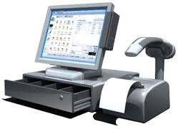
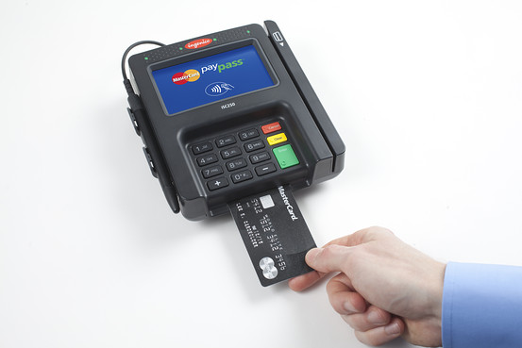
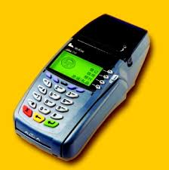
Point of Sale (POS) Devices
Notes:
Source: Winnie Yu & Lisa Lancor, Southern Connecticut State University. Downloaded from engage-csedu.org.

Slide 11
More Background on CCs
After card swiped at POS terminal, info sent to “acquirer” to check for credit authentication so merchant has a payment guarantee.
Acquirer checks validity
  Merchant ID
  Valid card number
  Expiration date
  Credit-card limit
  Card usage
Notes:
Source: Winnie Yu & Lisa Lancor, Southern Connecticut State University. Downloaded from engage-csedu.org.
We mention Chip & PIN technology and how it is coming and that the US is one of only 2 advanced countries that are not currently using the newer technology. All companies will be required to process Chip & PIN card in

Slide 12
Attacks Against Credit Cards
Skimmers
POS Devices
Notes:
Source: Winnie Yu & Lisa Lancor, Southern Connecticut State University. Downloaded from engage-csedu.org.

Slide 13
Skimmers
Notes:
Source: Winnie Yu & Lisa Lancor, Southern Connecticut State University. Downloaded from engage-csedu.org.

Slide 14
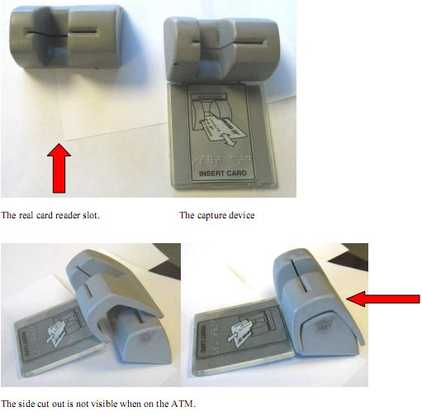
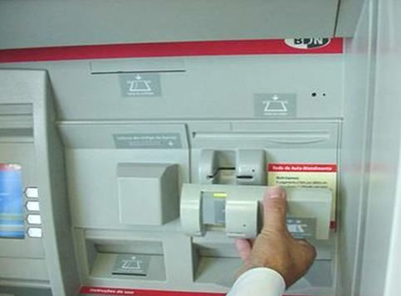
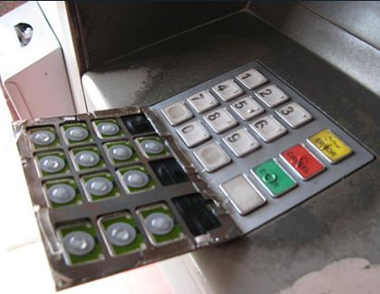
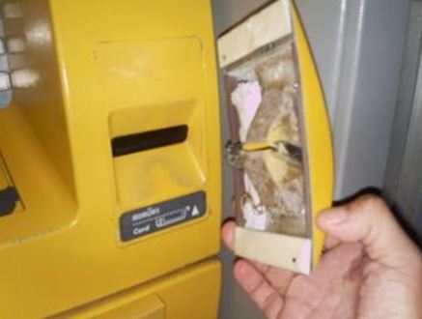
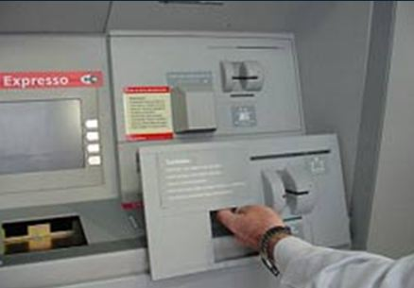
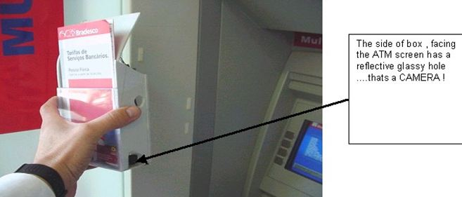
http://krebsonsecurity.com/2013/12/the-biggest-skimmers-of-all-fake-atms/
Notes:
Source: Winnie Yu & Lisa Lancor, Southern Connecticut State University. Downloaded from engage-csedu.org.

Slide 15
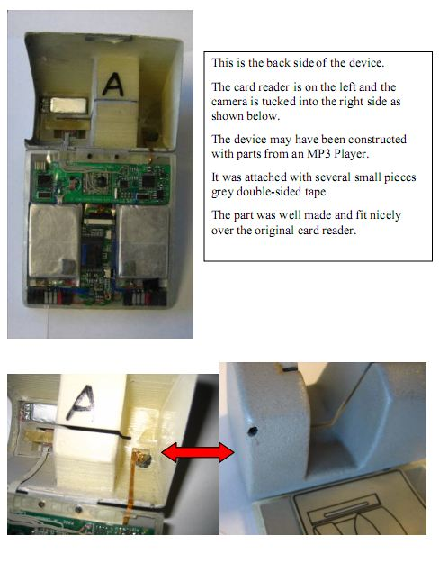
Notes:
Source: Winnie Yu & Lisa Lancor, Southern Connecticut State University. Downloaded from engage-csedu.org.

Slide 16
Security Breaches in the News
What organizations have you heard about that have been recently hacked?
What are some of the more famous hacks that you have heard about?
  They don’t have to be recent…
Notes:
Source: Winnie Yu & Lisa Lancor, Southern Connecticut State University. Downloaded from engage-csedu.org.

Slide 17
Let’s check out known 2015 hacks
Check out IBM’s Interactive Breach Site:
  http://www-03.ibm.com/security/xforce/xfisi/
  This site allows you to filter by location, industry type, or attack type
  Let’s check out
    Gov’t – June 12th’s OPM breach
    Retail (filter on US and Retail)
      POS breaches: Sept 1st, Sept 27th, Oct 23rd, Nov 13th, etc.
Notes:
Source: Winnie Yu & Lisa Lancor, Southern Connecticut State University. Downloaded from engage-csedu.org.

Slide 18
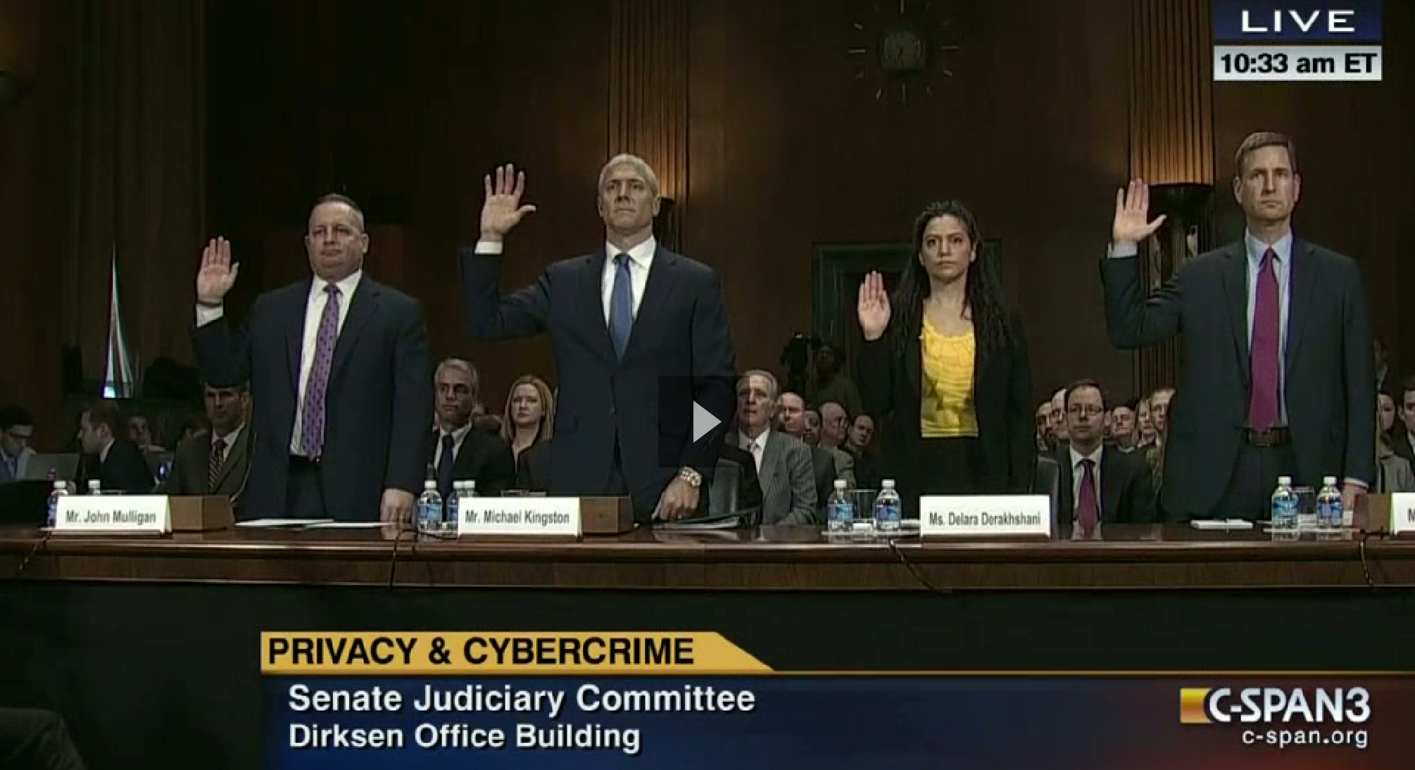
Target Breach
http://www.c-span.org/video/?317553-1/Cybercrime ; (2:47:44), Feb 4th 2014
Notes:
Source: Winnie Yu & Lisa Lancor, Southern Connecticut State University. Downloaded from engage-csedu.org.
Let’s talk about a famous POS Breach that you have probably all heard about….. The Target retail store breach in 2013…
Shown in Photo:
John Mulligan: Executive VP and CFO of Target
Michael Kingston: Sr VP and CIO or Neiman Marcus
Delara Deakshshani : Lead advocate for privacy (Consumer Reports)

Slide 19
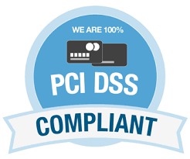
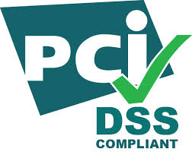
PCI-DSS Regulations
Stands for: Payment Card Industry – Data Security Standards
  Requires data at rest or being transmitted to be encrypted.
  Requires all access to the payment system to be authorized.
https://www.pcisecuritystandards.org/pci_security/
Notes:
Source: Winnie Yu & Lisa Lancor, Southern Connecticut State University. Downloaded from engage-csedu.org.
Any vendor who processes credit cards must adhere to the PCI-DSS regulations.
A discussion of Basic Encryption is important here and ties in directly with the CS1 programming project on the Caesar Cipher.
Target claimed that they DID adhere to all of the PCI-DSS regulations – especially these two important requirements…. So are they really at fault?

Slide 20
PCI-DSS Regulations
Problem:
  In US, payment card data cannot be encrypted when it is being processed.
Vulnerable point:
  After swipe, data is in memory of the POS system for processing the payment.
  Most POSs are running Windows CE on old devices that are very vulnerable to POS malware.
  Do a Memory (RAM) Scrape …What’s that?
Windows CE – Windows Embedded Compact: https://en.wikipedia.org/wiki/Windows_Embedded
Notes:
Source: Winnie Yu & Lisa Lancor, Southern Connecticut State University. Downloaded from engage-csedu.org.
Payment Card Industry – Data Security Standards Document

Slide 21
Malware: RAM Scraper
Dump memory for the POS process
  Process that has Track 2 data
Run a regular expression for Track 2 pattern
Store the extracted data locally;
Collect it later and send it out (usually encrypted)
https://www.youtube.com/watch?v=I2RrgqbjF9g&noredirect=1
Notes:
Source: Winnie Yu & Lisa Lancor, Southern Connecticut State University. Downloaded from engage-csedu.org.

Slide 22
40 Million Credit Cards stolen from Target
What do Hackers do with that information?
Notes:
Great source of information on this is Brian Krebs site (he is known to be the one who discovered that Target was breached even before they knew about it):
http://krebsonsecurity.com/2013/12/cards-stolen-in-target-breach-flood-underground-markets/

Slide 23
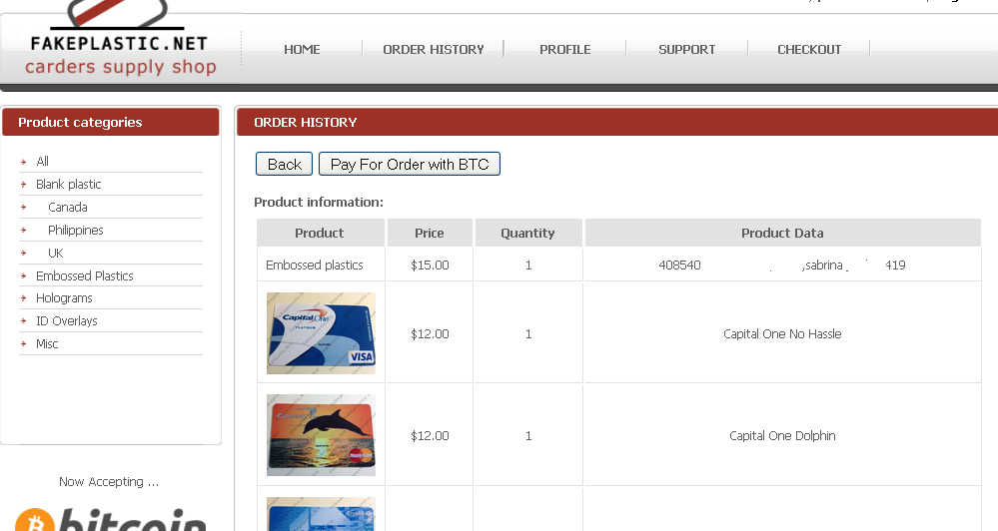
CC info sold on the Dark Web
http://krebsonsecurity.com/
Notes:
Source: Winnie Yu & Lisa Lancor, Southern Connecticut State University. Downloaded from engage-csedu.org.
Explain what the dark web is and what else is sold!!
This graphic shows the different types of credit cards you can order that contain stolen CC info.
BTC: are BitCoins (an anonymous digital currency). We talk about the current market value of a BTC.

Slide 24
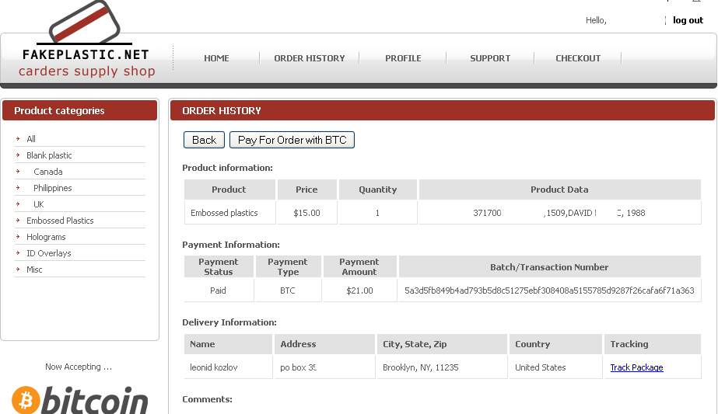
http://krebsonsecurity.com/
Notes:
Source: Winnie Yu & Lisa Lancor, Southern Connecticut State University. Downloaded from engage-csedu.org.

Slide 25
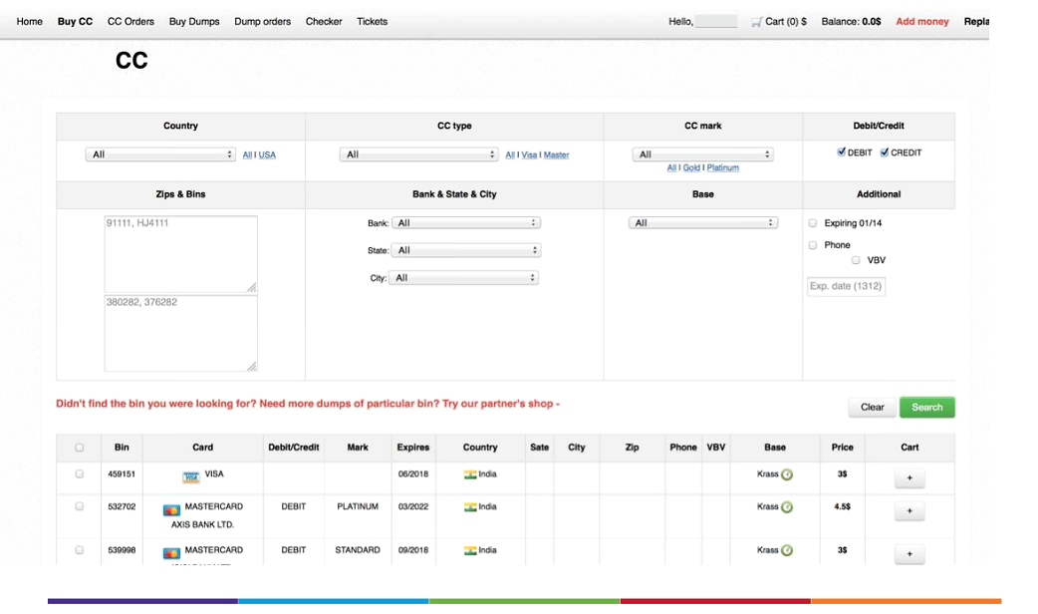
Card Shops (can order by Zip now)
http://krebsonsecurity.com/
Notes:
Source: Winnie Yu & Lisa Lancor, Southern Connecticut State University. Downloaded from engage-csedu.org.

Slide 26
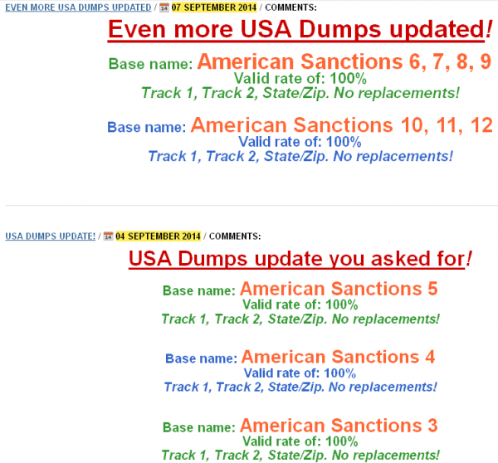
Card Shops
http://krebsonsecurity.com/
Notes:
Source: Winnie Yu & Lisa Lancor, Southern Connecticut State University. Downloaded from engage-csedu.org.
Here we talk about how card dumps are advertised in the Card Ships of the Dark Web. Clearly this was an attack against the Sanctions that the US was putting onto some foreign countries.

Slide 27
Digital Forensics of Target Breach
Initial intrusion into Target’s systems
  Traced back to network credentials that were stolen from a third party vendor.
  Third Party vendor: Fazio Mechanical (HVAC)
    refrigeration, heating and air conditioning subcontractor that has worked at a number of locations at Target and other top retailers.
    Other Fazio Mechanical contracts:
      Trader Joe’s, Whole Foods and BJ’s Wholesale Club
Notes:
Source: Winnie Yu & Lisa Lancor, Southern Connecticut State University. Downloaded from engage-csedu.org.

Slide 28
Why Give HVAC Company Network Access?
“Large retail operations typically have a team that routinely monitors energy consumption and temperatures in stores to save on costs (particularly at night) and to alert store managers if temperatures in the stores fluctuate outside of an acceptable range that could prevent customers from shopping at the store.”
Vendors remote into the system in order to do maintenance (updates, patches, etc.) or to troubleshoot glitches and connectivity issues with the software
    --KrebsOnSecurity
Notes:
Source: Winnie Yu & Lisa Lancor, Southern Connecticut State University. Downloaded from engage-csedu.org.

Slide 29
More on the Target Breach
Nov. 15 and Nov. 28, the attackers uploaded their card-stealing malicious software to a small number of cash registers within Target stores. This allowed them to test that their point-of-sale malware was working as designed.
Two days later, they pushed their malware to a majority of Target’s point-of-sale devices, and were actively collecting card records from live customer transactions until Dec. 15, 2013.
Notes:
Source: Winnie Yu & Lisa Lancor, Southern Connecticut State University. Downloaded from engage-csedu.org.

Slide 30
How to get the information out?
The stolen financial information was transmitted to several “drop” locations.
  Drop locations: compromised computers used to house stolen data and that could be safely accessed by the suspected
  Target’s stolen data was stashed on hacked computer servers belonging to a business in Miami, while another drop server resided in Brazil from there perpetrators in Eastern Europe and Russia picked up the data.
Notes:
Source: Winnie Yu & Lisa Lancor, Southern Connecticut State University. Downloaded from engage-csedu.org.

Slide 31
Is Target Liable?
They claimed they followed all PCI-DSS standards.
Current PCI standard says:
  Organizations are not required to maintain separate networks for payment and non-payment operations.
  It does require merchants to incorporate two-factor authentication for remote network access originating from outside the network by personnel and all third parties — including vendor access for support or maintenance (see section 8.3).
Notes:
Source: Winnie Yu & Lisa Lancor, Southern Connecticut State University. Downloaded from engage-csedu.org.
Here we talk about 2-factor Authentcation.
And if Target is liable

Slide 32
Target’s Latest Update
Target and PCI Auditor Trustwave have been sued by Banks to recover the cost of reissuing cards and lost funds.
Dec 2014: A U.S. judge allowed consumers to sue Target, rejecting Target's argument that the consumers lacked standing to sue because they could not establish any injury.
March 18th 2015: Target agreed to pay $10 million in a proposed settlement of a class-action lawsuit its data breach that consumers say compromised their personal financial info
  https://targetbreachsettlement.com/
Notes:
Source: Winnie Yu & Lisa Lancor, Southern Connecticut State University. Downloaded from engage-csedu.org.

Slide 33
CSC 152 (CS 1) Students
Your next steps…
We have looked at credit card technology and talked about the importance of encrypting data.
Your assignment focuses on one of the oldest encryption techniques called the Caesar Cipher (from the 1st Century BC)
  The Caesar cipher is a substitution cipher where each letter in the plaintext is replaced by a letter some fixed number of positions down the alphabet
  This cipher is NOT SECURE!! Not at all
Notes:
Source: Winnie Yu & Lisa Lancor, Southern Connecticut State University. Downloaded from engage-csedu.org.

Slide 34
CSC 153 (CS 2) Students – Part 1
Your next steps…
We have looked at credit card technology and talked about how data is stored on a credit card.
The first assignment looks at the Luhn Algorithm which is a widely used technique that provides a checksum that can validate a credit card number (as well as other ID numbers, e.g. IMEI mobile device numbers)
https://en.wikipedia.org/wiki/Luhn_algorithm
Notes:
Source: Winnie Yu & Lisa Lancor, Southern Connecticut State University. Downloaded from engage-csedu.org.

Slide 35
CSC 153 (CS 2) Students – Part 2
Your next steps…
The second assignment looks to build on the Luhn Algorithm assignment that you previously completed and allows you to build a program that will input a list of credit card info and their associated transactions and then output reports related to transaction validity and a set of summarized bills for valid transactions.
https://en.wikipedia.org/wiki/Luhn_algorithm
Notes:
Source: Winnie Yu & Lisa Lancor, Southern Connecticut State University. Downloaded from engage-csedu.org.

