Slide 1
Conditional Execution in Real-Time Simulations
Presenter: <INSERT YOUR NAME HERE>
Readings: <INSERT LINK TO THE LAB HERE>
SpaceSmasher V4 uses BlueJ (Java V1.8 or higher)
“Gamers make better ER Surgeons”

Slide 2
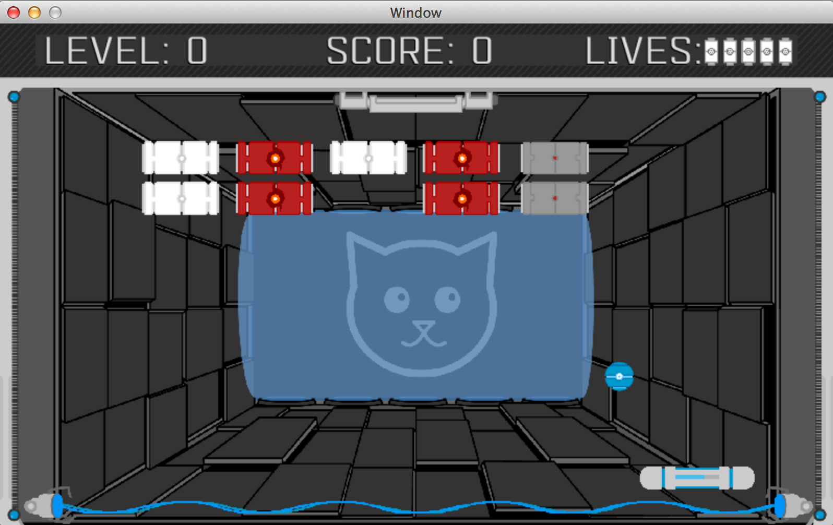
Introducing… SpaceSmasher!
Similar to Arkanoid, Block Breaker, Pong, etc.
(Provide Realtime Demo of Game Pictured Below)
Notes:
Use image and point to ball, paddle, block, iceball, lives, but for a better effect, offer a realtime demo of the game

Slide 3
How to Play: Labs in General
We have worked to define a lab culture and community that values individuals and collaborative teamwork.
To that end, we all must work together to…
  build a safe, encouraging environment in which to play
    Listen to the other, take turns, etc.
  form small groups that are inclusive of all types of gamers
    Try to understand versus dismiss differing viewpoints
  promote play, discovery, and growth together as a team
    Including bathing, brushing teeth, deodorant, etc.
Notes:
Sometimes, we make students pick a lab partner that they have never met before on the first day, and this leveling of the playing field where everybody knows nobody seems to offer a strong starting point to build community

Slide 4
How to Play: SpaceSmasher
Pick a TODO (0-9) and have your partner pick another
  Take turns with who gets to pick first
Using the website, read about the game feature you’ll build
  And then try out the premade solution in the game itself
Define a single method (which disables the solution)
  Get your method to match what my method solution does
    You’ll need helper methods (provided for you) to accomplish this
Show & Tell: After, show your team what you’ve just built
  And tell them the code that accomplished it
Notes:
If you decide to use an agile-based approach of 2 students to one computer, I would recommend turn taking for the coding up of each TODO.
Note that for #4,the students will frequently want to show YOU what they built.
Finally, note that to the more advanced programmer, they will notice that (3) is really overriding a method.

Slide 5
Pick a Method -
Then Experiment!
Method Name | Input | Output | Explanation
paddleMoveLeft() paddleMoveRight() | None | None | Moves the paddle for P1 left or right one unit, respectively.
areAllBlocksRemoved() | None | Boolean True/False | Is the blockSet empty on the screen?
gameWin() | None | None | Takes us to the game won screen and ends the game
ballCollidedWithPaddle() | None | Boolean True/False | Returns true if the ball and paddle images are overlapping onscreen
ballReflectOffPaddle() | None | None | The first ball in the ballSet has its speed in the y axis multiplied by -1
isMouseOnScreen() | None | Boolean True/False | Returns true if a mouse is connected and useable in our game.
Method Naming Convention: A target followed by an action: “paddleMoveLeft()”, “ballReflectOffPaddle()”
Notes:
They’re free, and made for you to use, so have fun with them!
Note that the Method Naming Convention is really just preparation for Object Oriented code, as in: “paddle.moveLeft();”
Note that the “is” prefix is missing from “ballCollidedWithPaddle”, and this will be fixed.

Slide 6
The Website is our Roadmap
http://faculty.washington.edu/rynn/lab_website/
(Show them the link they will use here; replace the one above)
Did you find the cheat codes yet? =)
Notes:
If you mention “up up down down left right left right…” after the cheat codes, some students may smile.

Slide 7
Lab Goals & Outcomes
Understanding & practice with:
  Single IF statements
  Single, Sequential IF statements
  Single IF/ELSE (with default else)
  Nested Single IF statements
  IF/ELSE using Logical &&
  IF/ELSE using Logical ||
  Multi-Way IF/ELSEIF (with no default else)
  Multi-Way IF/ELSE (with default else)
  Switch/Case statements

Slide 8
Custom Lab Pros & Cons
SpaceSmasher is a complex system with a simplified API
The concepts will follow along with your textbook, but the context will be our custom sandbox.
  Pros
    Examples
    Content
    Motivation
  Cons
    Setup
      Biggest gotcha: remember to run setupForPC or setupForMac
    Complexity
      You are in control of a smaller graphics engine
        And you may destroy it. Don’t be afraid to re-download and start fresh.
Notes:
It helps

Slide 9
At the End of Lab
A full SpaceSmasher experience
Lets finish parts of the game together
Start by reading the lab
  We’ll start together on TODO1

Slide 10
Single IF Flowchart
Start
Did the user press left on the keyboard?
Move paddle left:
paddle.moveLeft();
True
False

Slide 11
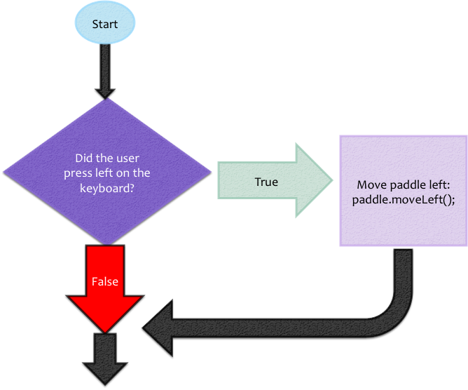
Single, Sequential IFs Flowchart
Conditional expressions are not logically related
True code paths are not mutually exclusive
A set of questions that each must be asked
  And if one is true ,this has no bearing on whether the other questions are asked
Notes:
Wed content to in-lab examples

Slide 12
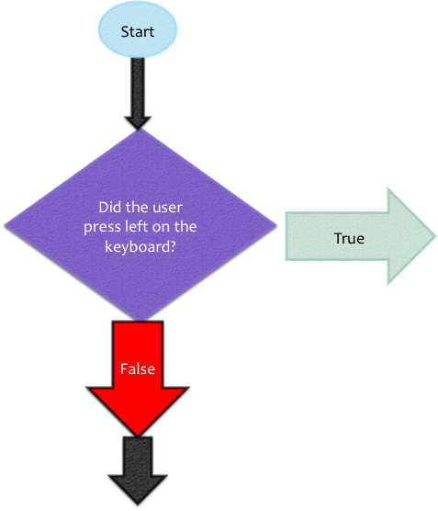
IFs Inside IFs (Nested)
Called Nested or Chained IF/ELSEs
Analogous to AND
if( x > 0 )
  if( x % 2 == 0 )
    if( x < 100 )
if(x > 0 && …?)
Notes:
Use blockbreaker examples in the code example

Slide 13
Which is Correct?
Analogous to AND
if( x > 0 )
  if( x % 2 == 0 )
    if( x < 100 )
if(x > 0 && …?)
if( x > 0 && x % 2 == 0)
if( x > 0 && ( x % 2 || x < 100) )
if( x > 0 && x % 2 == 0 && x < 100)
if( x > 0 && x % 2 == 0 && x < 99)

Slide 14
Single, Sequential IFs V.S. Chained IF/ELSEs
Which of the following are true regarding Sequential IFs?
Which of the following are true regarding Chained IF/ELSEs?

Slide 15
In The Beginning…
(TODO0, TODO1, TODO2, …)
Paddles don’t work…
  No keyboard support for movement
  No mouse support for movement
    Spawning only
  No collision support
  They do change when an upgrade block is hit
Balls don’t work…
  They pass right through the paddle
  They don’t change with the paddle
    To an IceBall or FireBall
How do I even know what a “ball” or “paddle” is?
  The key is in the comments in each TODO

Slide 16
Methods For Experimentation
Method Name | Input | Output | Explanation
paddleMoveLeft() paddleMoveRight() | None | None | See name
areAllBlocksRemoved() | None | Boolean True/False | Is the blockSet empty on the screen?
gameWin() | None | None | Takes us to the game won screen and ends the game
ballCollidedWithPaddle() | None | Boolean True/False | Returns true if the ball and paddle images are overlapping onscreen
ballReflectOffPaddle() | None | None | The first ball in the ballSet has its speed in the y axis multiplied by -1
isMouseOnScreen() | None | Boolean True/False | Returns true if a mouse is connected and useable in our game.
Format: <thing> then <action>, as in: <paddle><MoveLeft> == “paddleMoveLeft();”
Notes:
They’re free, and made for you to use, so have fun with them!

Slide 17
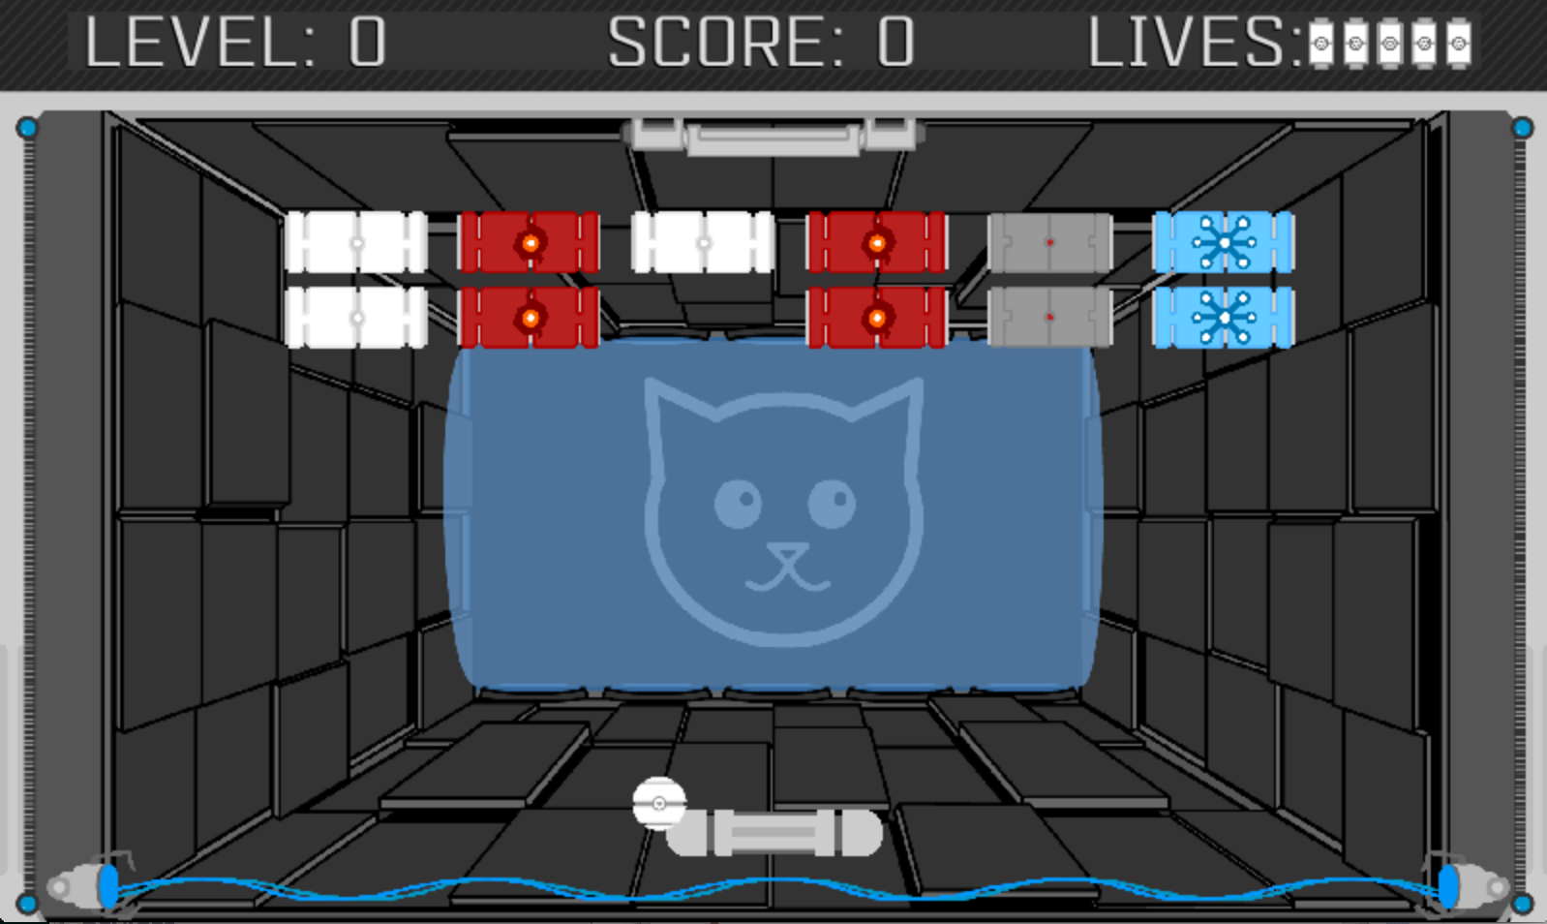
Lab Activities – TODO 1
Outcome: Add collision detection to the paddle
  Currently, the ball goes right through the paddle!
  We would like the ball to be bounced (or reflected)
    But only IF the paddle collides with the ball
      ballCollidedWithPaddle(); //returns true or false
Fix this using “if”

Slide 18
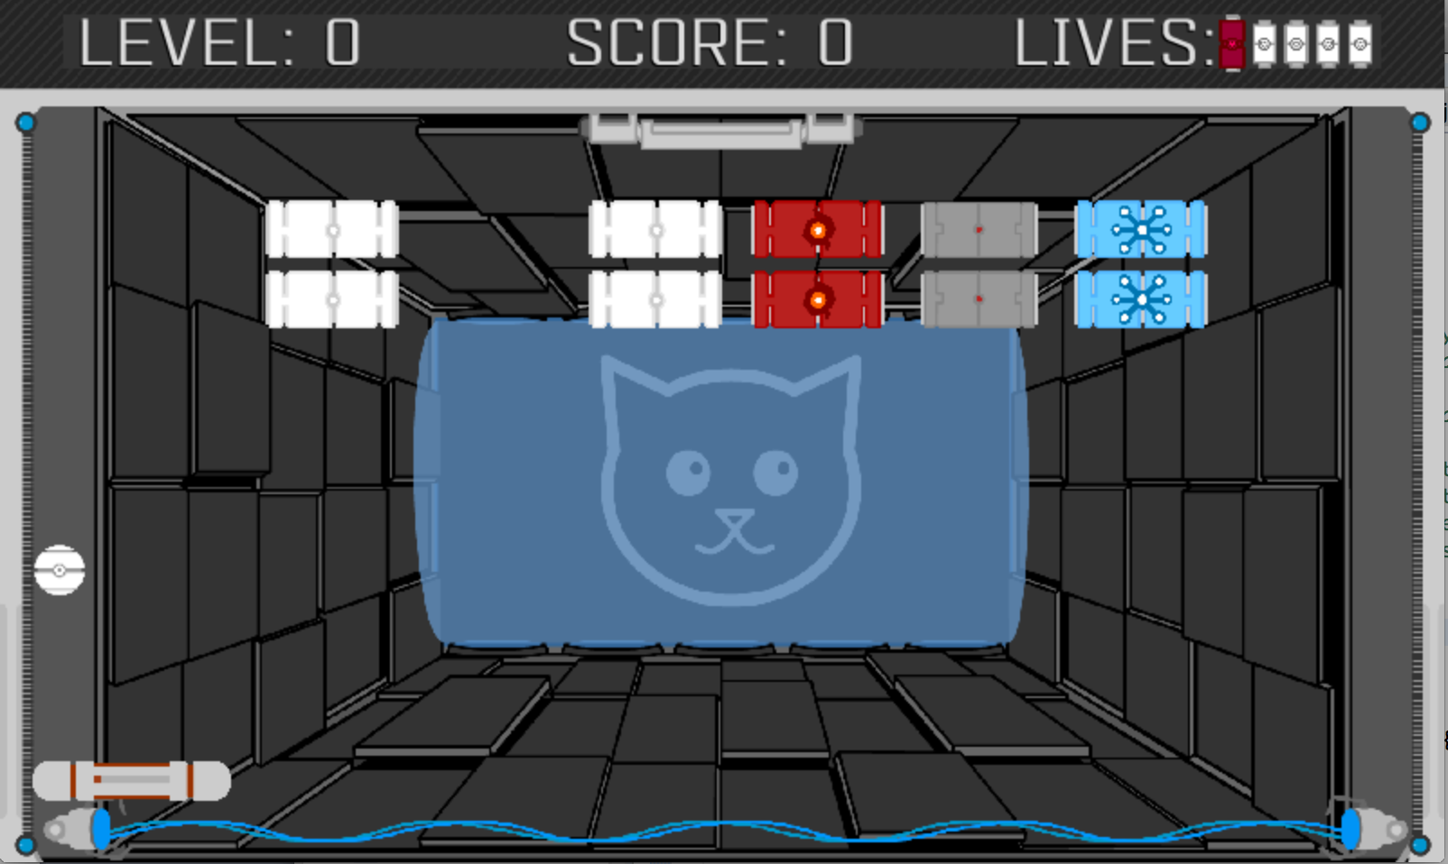
Lab Activities – TODO 3
Outcome: Move the paddle left or right via the keyboard
  We’d like to move the paddle left when “LEFT” is pressed
    (Or WASD)
  And, move the paddle right with the “RIGHT” key
Moves left with left arrow key

Slide 19
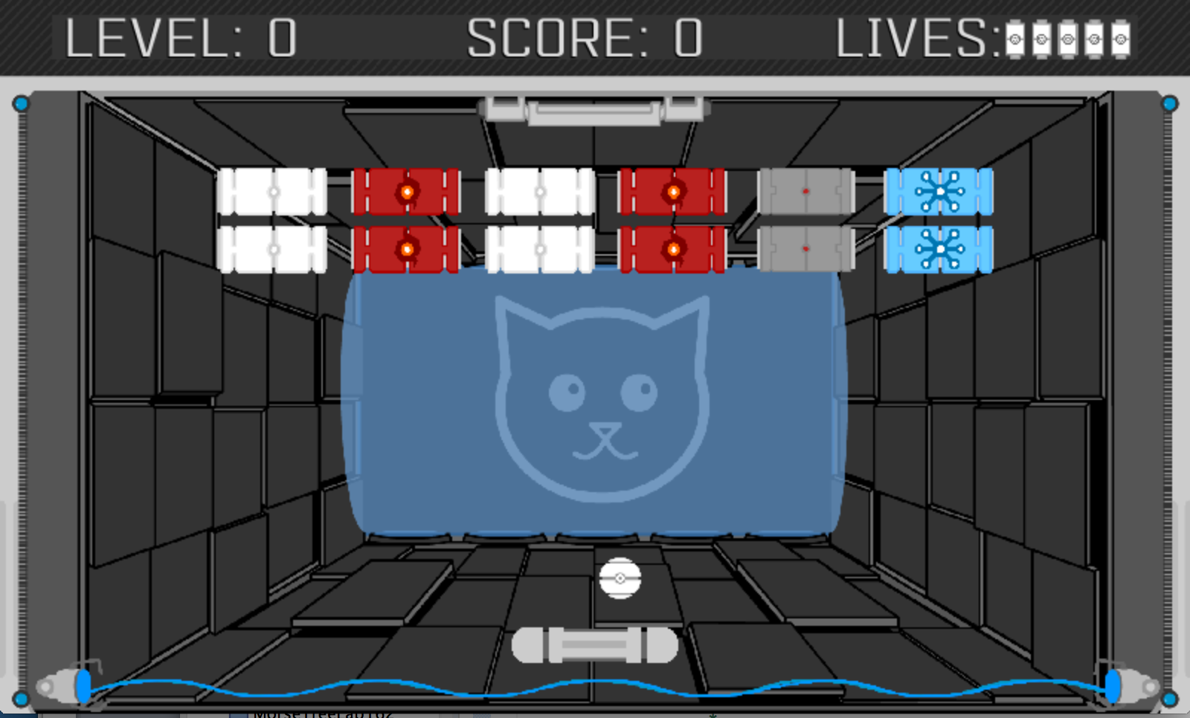
Lab Activities – TODO 5
Outcome: Make a ball appear near the paddle
  But, only if the user presses “spacebar”
    We’ll call this “spawning” the ball near the paddle
      ballSpawnNearPaddle();
Spawned with Spacebar

Slide 20
Lab Activities Continued
In TODO3-TODO6, you’ll build out your game even more.
Then, we’ll redesign (refactor) some existing code
  To make it shorter and clearer
  And so that it uses logical AND (“&&” in Java)
Final outcome: Power up the paddle corresponding to the state of the ball.
  If the ball is a fireball, set the paddle to fire mode
  If the ball is an iceball, set the paddle to ice mode
  If the ball is normal, set the paddle to normal mode

Slide 21
At the End…
A full SpaceSmasher experience
  And a starting point for the next conditionals assignment
    (these are not linearly dependent)
Also, extra activities have been embedded for those who want to extend the lab or assignment further (TODO_Xs)
And, extra methods have been defined and described in each TODOs comments
  Making a 2-player game? “paddleMoveLeft()” only affects p1!
    Check out paddleMoveLeft(int index), and use 0 for p1, 1 for p2, etc.

Slide 22
Building Even More Games
Once the lab is complete, look at the extended methods in each TODO.
  How could you take this game even farther?
What about a version of this game that moves in both the x and y axis?
Or, what about a version of this game that uses two paddles and is 2 player?
Or, what about a Multi-Ball power up?
  This last idea is the focus of the next conditionals assignment, if interested…

Slide 23
To Get Started in BlueJ
Download the “SpaceSmasherInBlueJ” starter project
Unzip this file (typically a double-click or right click)
Click on setupForPC or setupForMac (the first time only)
Open the project by clicking on the “package.blueJ” file
Using the Website as a guide, start at TODO 0.

Slide 24
Troubleshooting Tips
Problem: “Package SpaceSmasher does not exist!”
  Solution: run setupForPC or setupForMac
  Solution: Configure your library includes manually!
    Covered on the next slide via pretty pictures.
      More Troubleshooting tips on the website, too.

Slide 25
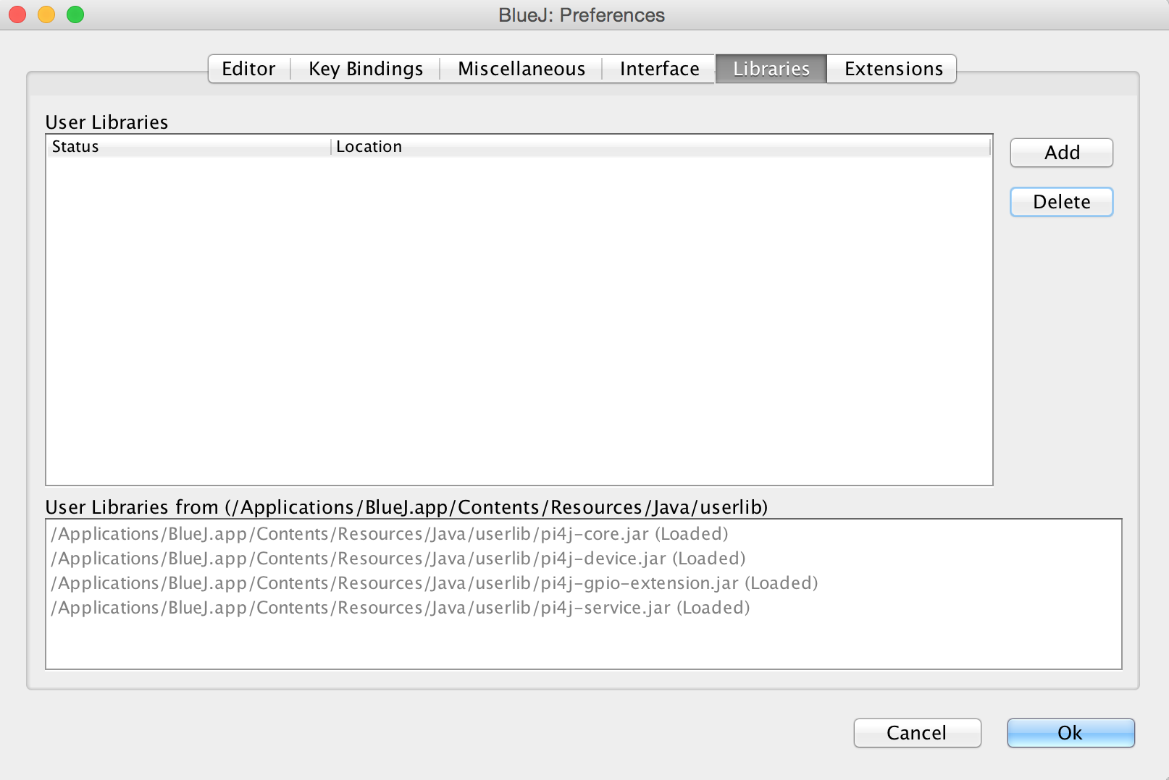
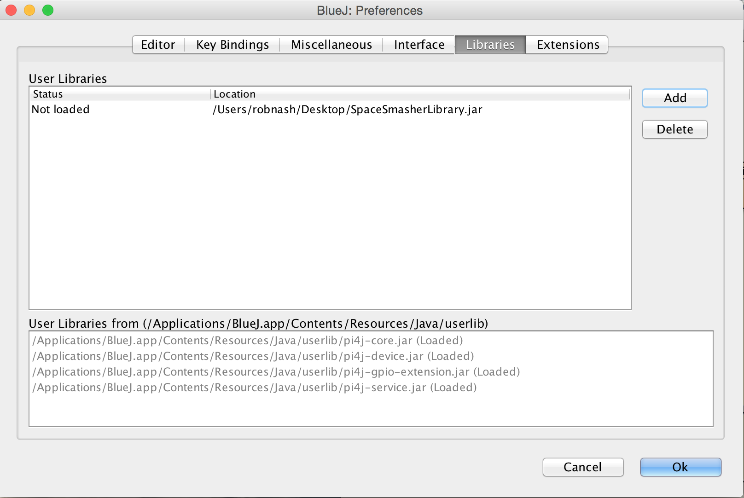
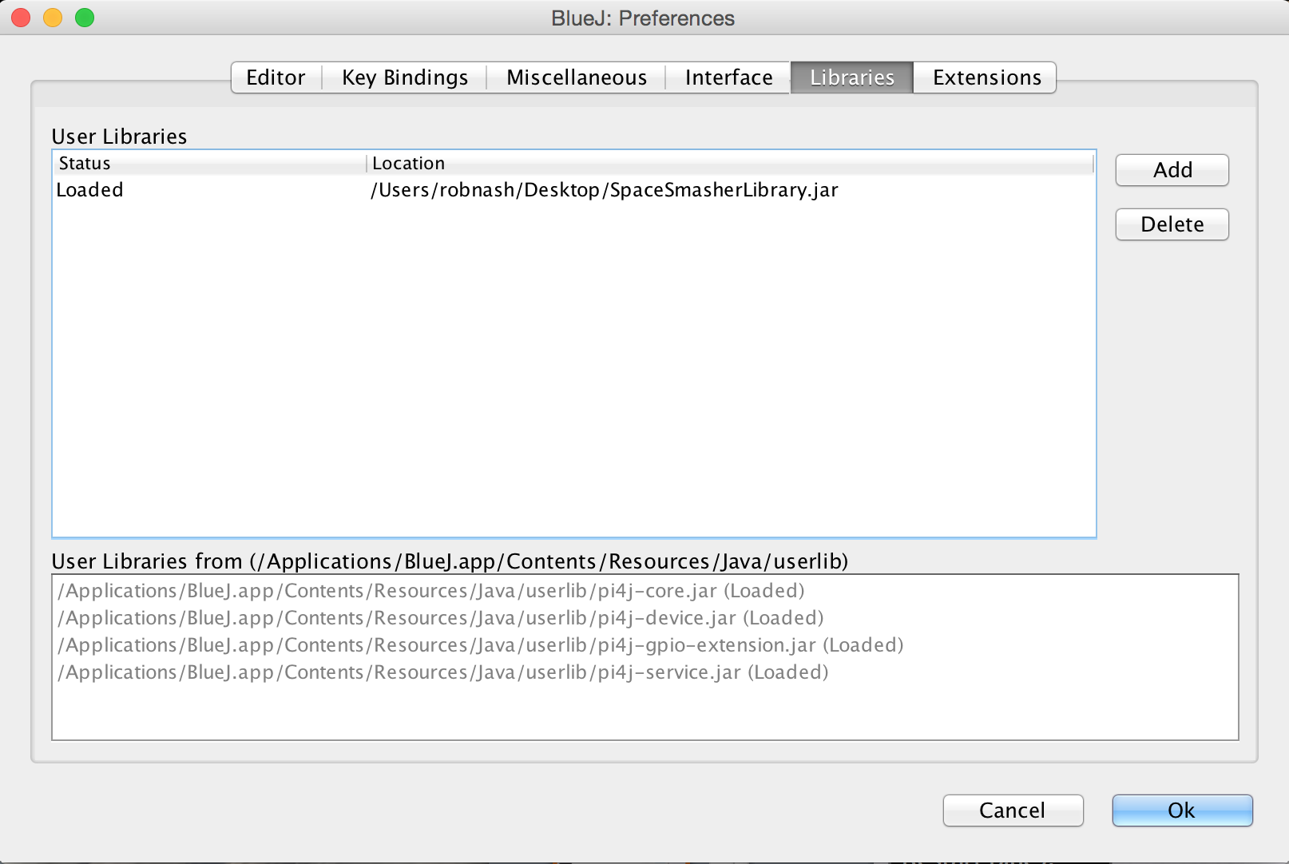
Library
Config
1. Add Library
2. Restart BlueJ
Remember to restart BlueJ!
Notes:
Note that this step is only necessary if they setupForPC or setupForMac scripts failed! This is how to manually link to the library you need, and the scripts do this for you.

Slide 26
TroubleShooting:
OutOfHeapSpace?
If you run out of memory while loading images, you should increase the minimum and maximum heap values for the Java VM
In blueJ, look for the property:
  “bluej.windows.vm.args”
On the command line:
“Java –Xmx512M –Xms1024M”

